Slide 1
Design and Implementation of a Smart Parking System
MSc Computer Science , 1st Semester University of Calcutta

Slide 2
Problem Statement:
The objective of this project is to develop a Smart Parking System (SPS) that efficiently manages parking spaces in urban environments.
The SPS is designed to optimize parking space utilization, enhance user experience, and provide real-time monitoring and management capabilities.
Notes:
The objective of this project is to develop a Smart Parking System (SPS) that efficiently manages parking spaces in urban environments. The SPS is designed to optimize parking space utilization, enhance user experience, and provide real-time monitoring and management capabilities.

Slide 3
Smart Parking System Assumptions
Limited Access: Controlled entry and exit points managed by the system.
Defined Parking Spaces: Predefined slots for different vehicle types.
Sensor Integration: Real-time occupancy detection for dynamic space allocation.
Tagged Vehicles: Vehicles equipped with tags for identification and access control.
Centralized Management: Centrally managed system with a centralized database.
User Interaction: User-friendly interface for seamless parking transactions.
Redundancy Mechanisms: Backup systems ensure fault tolerance and reliability.
Notes:
The primary assumption of the Smart Parking System problem is that the system operates within a controlled environment, such as a designated parking facility or urban area, where the following conditions hold true:
Limited Access: The parking facility has defined entry and exit points where vehicles are allowed to enter and exit. Access to the parking facility is controlled and managed by the Smart Parking System.
Defined Parking Spaces: The parking facility consists of predefined parking slots or spaces where vehicles can be parked. These parking spaces may vary in size and type to accommodate different types of vehicles.
Sensor Integration: The parking slots are equipped with sensors that can detect the presence or absence of vehicles. These sensors provide real-time data on parking slot occupancy, enabling the system to dynamically manage parking space allocation.
Tagged Vehicles: Vehicles entering the parking facility are equipped with parking tags, either Active Tags or Passive Tags, which are used for vehicle identification and access control within the facility. These tags are essential for tracking vehicles and managing access to parking spaces.
Centralized Management: The Smart Parking System is centrally managed by a Central Server, which connects to a centralized database storing information about parking slot statuses, vehicle data, and transaction records. The Central Server enables centralized monitoring, management, and reporting of parking operations.
User Interaction: The system provides a user-friendly interface for vehicle owners to interact with, enabling them to check parking availability, enter the parking facility, pay for parking, and exit the facility seamlessly.
Redundancy Mechanisms: The system incorporates redundancy mechanisms, including a Temporary Server, to ensure fault tolerance and reliability. These mechanisms help mitigate system failures and ensure uninterrupted parking operations.
Compliance with Regulations: The Smart Parking System complies with relevant regulations and standards governing parking facilities, data privacy, security, and safety. It adheres to legal requirements to ensure the safety and security of vehicles and occupants within the parking facility.

Slide 4
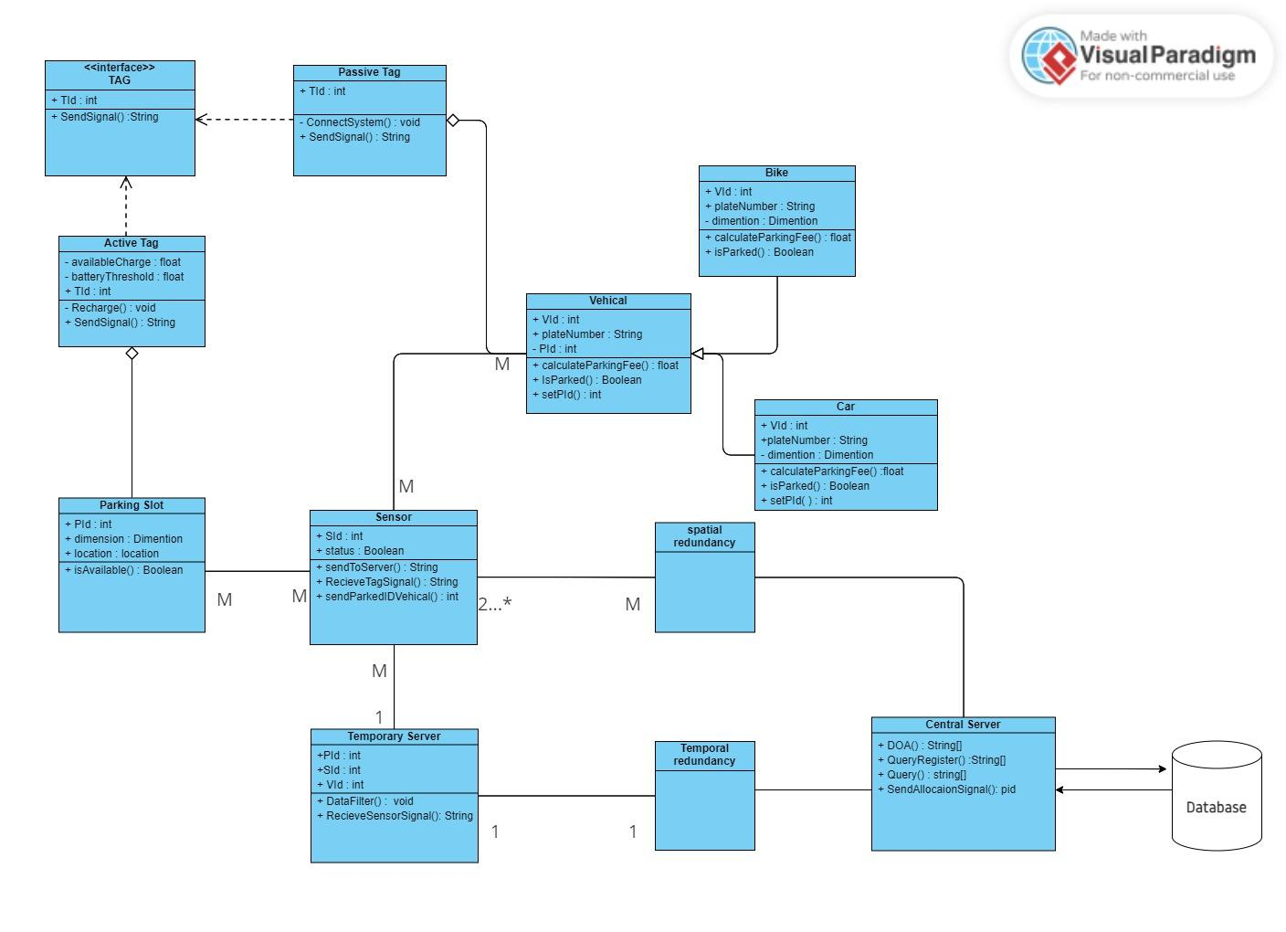

Slide 5
The Sequence Diagram

Slide 6
The Use-Case Diagram

Slide 7
Conclusion
In conclusion, the implementation of a smart parking system with RFID tags offers a promising solution to the challenges of urban parking.
By integrating RFID technology, this system enhances efficiency, reduces congestion, and provides a user-friendly experience.
The RFID tags enable quick and secure access, contributing to a more streamlined and automated parking process.
As cities continue to embrace smart infrastructure, such innovations hold great potential in optimizing urban mobility and improving overall urban living.

Slide 8
Thank You!!

